Slide 1
MAVEN TOOL

Slide 2
Common problem activities
Multiple jars
Ex: For instance: To create hibernate application, we need many jars and we should remember all the jars
Dependencies and versions
Some jars have dependencies, So We should add those dependency jars also.
Only some features are specific to some versions of the jar. So we should take care of everything
Project Structure
For instance Web application should have the proper project structure, then only it is executed properly.
Building, Publishing and Deploy

Slide 3
Maven
It resolves the all common problems

Slide 4
What is Build Tool?
A build tool takes care of everything for building a process. It does following:
Generates source code (if auto-generated code is used)
Generates documentation from source code
Compiles source code
Packages compiled code into JAR of ZIP file
Installs the packaged code in local repository, server repository, or central repository

Slide 5
What is MAVEN?
Maven is a build tool.
Maven is a powerful project management tool that is based on POM (project object model).
It is used for projects build, dependency and documentation.
It simplifies the build process like ANT. But it is too much advanced than ANT.
Current version of Maven is 3.

Slide 6
What MAVEN does?
It makes a project easy to build
It provides uniform build process (maven project can be shared by all the maven projects)
It provides project information (log document, cross referenced sources, mailing list, dependency list, unit test reports etc.)
It is easy to migrate for new features of Maven

Slide 7
Understanding the problem without Maven
There are many problems that we face during the project development.
1) Adding set of Jars in each project: In case of struts, spring, hibernate frameworks, we need to add set of jar files in each project. It must include all the dependencies of jars also.
2) Creating the right project structure: We must create the right project structure in servlet, struts etc, otherwise it will not be executed.
3) Building and Deploying the project: We must have to build and deploy the project so that it may work.

Slide 8
Apache Maven helps to manage in..
Builds
Documentation
Reporting
SCMs
Releases
Distribution

Slide 9
ANT & MAVEN
Ant and Maven both are build tools provided by Apache.
The main purpose of these technologies is to ease the build process of a project.

Slide 10
Difference between Ant and Maven
Ant | Maven
Ant doesn't has formal conventions, so we need to provide information of the project structure in build.xml file. | Maven has a convention to place source code, compiled code etc. So we don't need to provide information about the project structure in pom.xml file.
Ant is procedural, you need to provide information about what to do and when to do through code. You need to provide order. | Maven is declarative, everything you define in the pom.xml file.
There is no life cycle in Ant. | There is life cycle in Maven.
It is a tool box. | It is a framework.
It is mainly a build tool. | It is mainly a project management tool.
The ant scripts are not reusable. | The maven plugins are reusable.
It is less preferred than Maven. | It is more preferred than Ant.
Ant and Maven both are build tools provided by Apache. The main purpose of these technologies is to ease the build process of a project.

Slide 11
Download, Install, Run Maven

Slide 12
System Requirements
Java Development Kit (JDK) | Maven 3.3 requires JDK 1.7 or above to execute - it still allows you to build against 1.3 and other JDK versions by Using Toolchains
Memory | No minimum requirement
Disk | Approximately 10MB is required for the Maven installation itself. In addition to that, additional disk space will be used for your local Maven repository. The size of your local repository will vary depending on usage but expect at least 500MB.
Operating System | No minimum requirement. Start up scripts are included as shell scripts and Windows batch files.

Slide 13
Installing Apache Maven
The installation of Maven is a simple process of extracting the archive and bin folder with the mvn command to the PATH
Details steps are below
Ensure JAVA_HOME environment variable is set and points to your JDK installation.
Extract distributed archive in any directory.
1. unzip apache-maven-3.3.3-bin.zip (or)
tar xzvf apache-maven-3.3.3-bin.tar.gz
Set maven bin directory to the path variable

Slide 14
Windows Tips
Check environment variable value
Echo %JAVA_HOME%
Mvn
Mvn -version

Slide 15
How to install Maven on windows
We can download and install maven on windows, linux and MAC OS platforms.
Steps to install maven on windows OS.
Download maven and extract it
Add both MAVEN_HOME and M2_HOME in environment variable
Add maven path in environment variable
Verify Maven

Slide 16
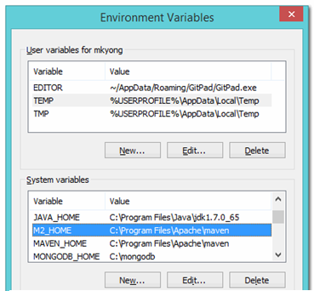
MAVEN_HOME and M2_HOME

Slide 17
Note
M2_HOME or MAVEN_HOME Maven document said add M2_HOME only, but some programs still reference Maven folder with MAVEN_HOME, so, it’s safer to add both.

Slide 18
1) Download Maven
Download Maven latest Maven software from http://maven.apache.org/download.cgi
For example apache-maven-3.3.3-bin.zip
Extract it. Now it will look like below:

Slide 19
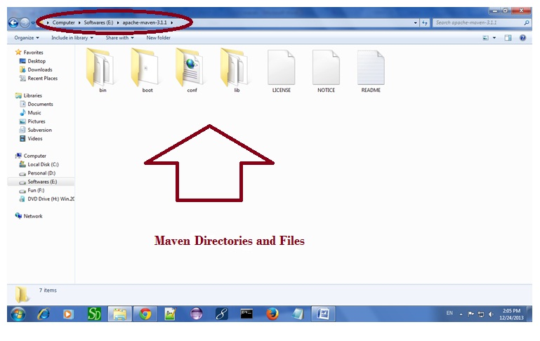

Slide 20
2) Add MAVEN_HOME in environment variable
Right click on MyComputer -> properties -> Advanced System Settings -> Environment variables -> click new button
Now add MAVEN_HOME in variable name and path of maven in variable value. It must be the home directory of maven i.e. outer directory of bin. For example: E:\apache-maven-3.1.1 .It is displayed below:

Slide 21
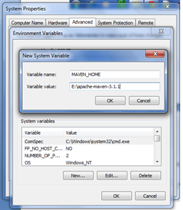

Slide 22
3) Add Maven Path in environment variable
Click on new tab if path is not set, then set the path of maven. If it is set, edit the path and append the path of maven.
Here, we have installed JDK and its path is set by default, so we are going to append the path of maven.
The path of maven should be %maven home%/bin. For example, E:\apache-maven-3.1.1\bin .

Slide 23
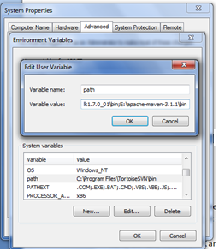

Slide 24
4)Verify maven
To verify whether maven is installed or not, open the command prompt and write:
mvn −version
Now it will display the version of maven and jdk including the maven home and java home

Slide 25
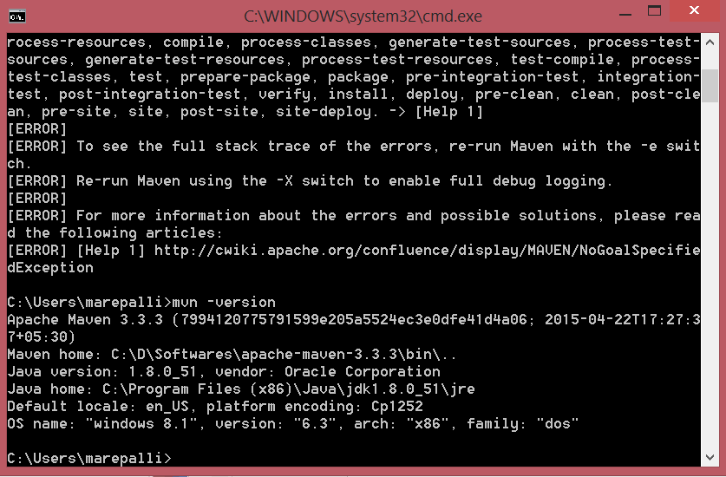

Slide 26
Maven Repository

Slide 27
Maven Repository
A maven repository is a directory of packaged JAR file with pom.xml file. Maven searches for dependencies in the repositories. There are 3 types of maven repository:
Local Repository
Central Repository
Remote Repository

Slide 28
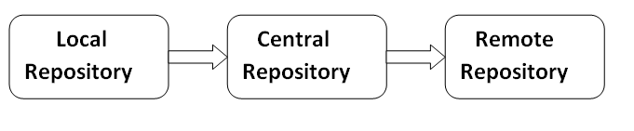
Maven searches for the dependencies in the following order:
Local repository then Central repository then Remote repository.

Slide 29
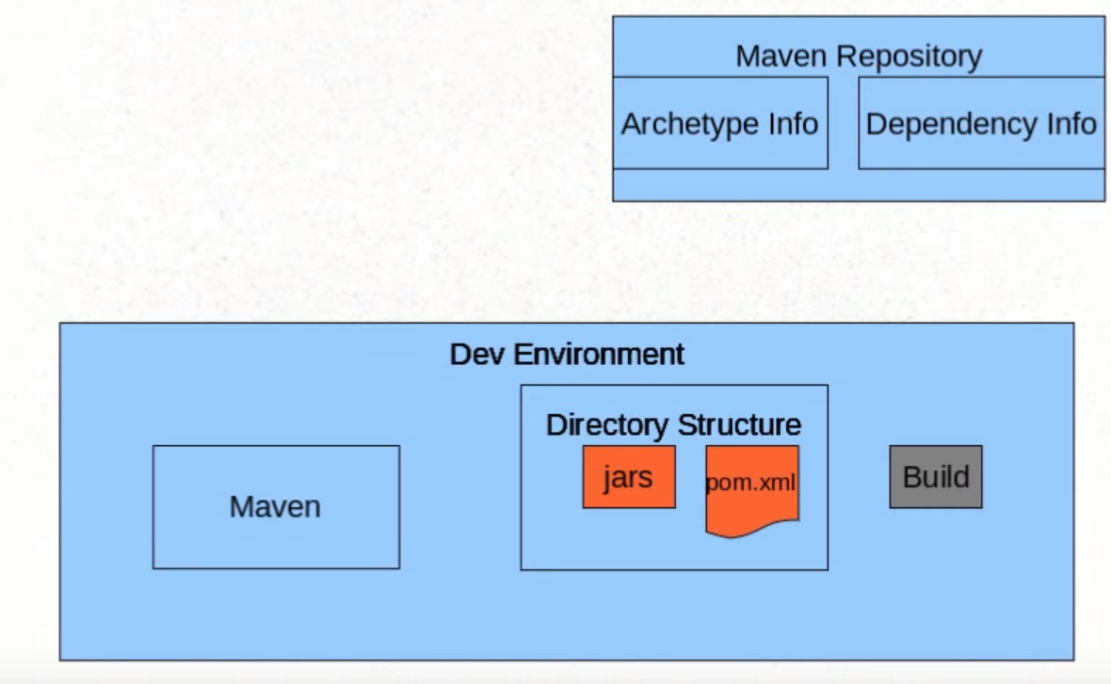

Slide 30
Note
If dependency is not found in these repositories, maven stops processing and throws an error.

Slide 31
1) Maven Local Repository
Maven local repository is located in your local system. It is created by the maven when you run any maven command.
By default, maven local repository is %USER_HOME%/.m2 directory. For example: C:\Users\marepalli\.m2.

Slide 32
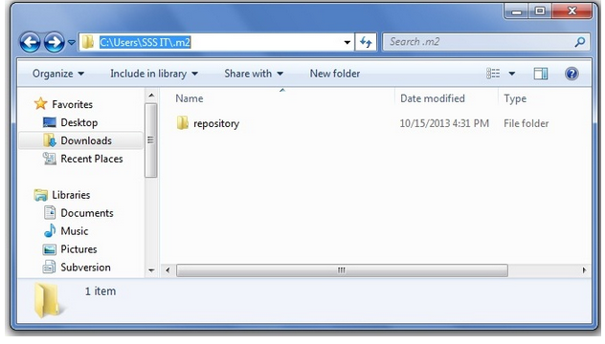

Slide 33
Update location of Local Repository
We can change the location of maven local repository by changing the settings.xml file. It is located in MAVEN_HOME/conf/settings.xml, for example: E:\apache-maven-3.1.1\conf\settings.xml

Slide 34
settings.xml
...
<settings xmlns="http://maven.apache.org/SETTINGS/1.0.0"
xmlns:xsi="http://www.w3.org/2001/XMLSchema-instance"
xsi:schemaLocation="http://maven.apache.org/SETTINGS/1.0.0 http://maven.apache.org/xsd/settings-1.0.0.xsd">
<!-- localRepository
| The path to the local repository maven will use to store artifacts.
|
| Default: ${user.home}/.m2/repository
<localRepository>/path/to/local/repo</localRepository>
-->
...
</settings>

Slide 35
After changing the path of local repository, it will look like this:
Settings.xml
...
<settings xmlns="http://maven.apache.org/SETTINGS/1.0.0"
xmlns:xsi="http://www.w3.org/2001/XMLSchema-instance"
xsi:schemaLocation="http://maven.apache.org/SETTINGS/1.0.0 http://maven.apache.org/xsd/settings-1.0.0.xsd">
<localRepository>e:/mavenlocalrepository</localRepository>
...
</settings>

Slide 36
2) Maven Central Repository
Maven central repository is located on the web. It has been created by the apache maven community itself.
The path of central repository is: http://repo1.maven.org/maven2/.
The central repository contains a lot of common libraries that can be viewed by this url http://search.maven.org/#browse.

Slide 37
3) Maven Remote Repository
Maven remote repository is located on the web. Most of libraries can be missing from the central repository such as JBoss library etc, so we need to define remote repository in pom.xml file.
Let's see the code to add the jUnit library in pom.xml file.

Slide 38
Pom.xml
<project xmlns="http://maven.apache.org/POM/4.0.0"
xmlns:xsi="http://www.w3.org/2001/XMLSchema-instance"
xsi:schemaLocation="http://maven.apache.org/POM/4.0.0
http://maven.apache.org/xsd/maven-4.0.0.xsd">
<modelVersion>4.0.0</modelVersion>
<groupId>com.myit.application1</groupId>
<artifactId>my-application1</artifactId>
<version>1.0</version>
<packaging>jar</packaging>
<name>Maven Quick Start Archetype</name>
<url>http://maven.apache.org</url>
<dependencies>
<dependency>
<groupId>junit</groupId>
<artifactId>junit</artifactId>
<version>4.8.2</version>
<scope>test</scope>
</dependency>
</dependencies>
</project>

Slide 39
Note
You can search any repository from Maven official website mvnrepository.com.

Slide 40
Maven pom.xml file
pom.xml file

Slide 41
pom.xml
POM is an acronym for Project Object Model. The pom.xml file contains information of project and configuration information for the maven to build the project such as dependencies, build directory, source directory, test source directory, plugin, goals etc.
Maven reads the pom.xml file, then executes the goal.
Before maven 2, it was named as project.xml file. But, since maven 2 (also in maven 3), it is renamed as pom.xml.

Slide 42
Elements of maven pom.xml file
Element | Description
project | It is the root element of pom.xml file.
modelVersion | It is the sub element of project. It specifies the modelVersion. It should be set to 4.0.0.
groupId | It is the sub element of project. It specifies the id for the project group.
artifactId | It is the sub element of project. It specifies the id for the artifact (project). An artifact is something that is either produced or used by a project. Examples of artifacts produced by Maven for a project include: JARs, source and binary distributions, and WARs.
version | It is the sub element of project. It specifies the version of the artifact under given group.

Slide 43
pom.xml
<project xmlns="http://maven.apache.org/POM/4.0.0"
xmlns:xsi="http://www.w3.org/2001/XMLSchema-instance"
xsi:schemaLocation="http://maven.apache.org/POM/4.0.0
http://maven.apache.org/xsd/maven-4.0.0.xsd">
<modelVersion>4.0.0</modelVersion>
<groupId>com.myit.application</groupId>
<artifactId>my-app</artifactId>
<version>1</version>
</project>

Slide 44
Maven pom.xml file with additional elements
Element | Description
packaging | defines packaging type such as jar, war etc.
name | defines name of the maven project.
url | defines url of the project.
dependencies | defines dependencies for this project.
dependency | defines a dependency. It is used inside dependencies.
scope | defines scope for this maven project. It can be compile, provided, runtime, test and system.

Slide 45
pom.xml with additional elements
<modelVersion>4.0.0</modelVersion>
<groupId>com.myit.application</groupId>
<artifactId>my-application</artifactId>
<version>1.0</version>
<packaging>jar</packaging>
<name>Maven Quick Start Archetype</name>
<url>http://maven.apache.org</url>
<dependencies>
<dependency>
<groupId>junit</groupId>
<artifactId>junit</artifactId>
<version>4.8.2</version>
<scope>test</scope>
</dependency>
</dependencies>

Slide 46
<dependencies> tag in pom.xml
<dependencies> tag.
It downloads all the required jars.
Just mention the required jars, maven will take care about required jars

Slide 47
Simple Maven Example

Slide 48
Note
Group Id represents package name
Artifact Id represents Project name

Slide 49
Maven Example
To create a simple java project using maven, you need to open command prompt and run the archetype:generate command of mvn tool.

Slide 50
The syntax to generate the project architecture is given below:
mvn archetype:generate -DgroupId=groupid -DartifactId=artifactid
-DarchetypeArtifactId=maven-archetype-quickstart -
-DinteractiveMode=booleanValue
Example
mvn archetype:generate -DgroupId=com.myit -DartifactId=CubeGenerator
-DarchetypeArtifactId=maven-archetype-quickstart -DinteractiveMode=false

Slide 51
Note
Here, we are using
maven-archetype-quickstart or mention the number of type of the application to create simple maven core project.
if you use maven-archetype-webapp, it will generate a simple maven web application.

Slide 52
Generated Directory Structure
CubeGenerator
-src
--main
---java
----com
-----myit
------App.java
--test
---java
----com
-----myit
------AppTest.java
-pom.xml

Slide 53
Observation
As you can see, there are 3 files generated automatically.
1. pom.xml
2. App.java
3. AppTest.java

Slide 54
Compile the Maven Java Project
To compile the project, go to the project directory,
for example: C:\Users\marepalli\CubeGenerator and write the following command on the command prompt:
mvn clean compile
Now, you will see a lot of execution on the command prompt. If you check your project directory, target directory is created that contains the class files.

Slide 55
Note
Run the mvn commands from pom.xml file directory.
Ex: mvn compile
Mvn test

Slide 56
Run the Maven Java Project
To run the project, go to the project directory\target\classes,
for example: C:\Users\marepalli\CubeGenerator\target\classes and write the following command on the command prompt:
java com.myit.App
Output of the maven example
Hello World!

Slide 57
How to build the maven project or how to package maven project?
The mvn package command completes the build life cycle of the maven project such as:
validate
compile
test
package
integration-test
verify
install
deploy

Slide 58
Build Lifecycle commands
validate - validate the project is correct and all necessary information is available
compile - compile the source code of the project
test - test the compiled source code using a suitable unit testing framework. These tests should not require the code be packaged or deployed
package - take the compiled code and package it in its distributable format, such as a JAR.
integration-test - process and deploy the package if necessary into an environment where integration tests can be run
verify - run any checks to verify the package is valid and meets quality criteria
install - install the package into the local repository, for use as a dependency in other projects locally
deploy - done in an integration or release environment, copies the final package to the remote repository for sharing with other developers and projects.

Slide 59
Note
All commands should be run from pom.xml file location

Slide 60
Maven Package
You need to execute the following command on the command prompt to package the maven project:
mvn package
Now you will see that a jar file is created inside the project/target directory.
You can also run the maven project by the jar file. To do so, go to the maven project directory, for example: C:\Users\marepalli\CubeGenerator and execute the following command on the cmd:
java -classpath target\CubeGenerator-1.0-SNAPSHOT.jar;.; com.myit.App

Slide 61
Maven Web Application

Slide 62
Maven Web Application
We can create a simple maven web application example by executing the archetype:generate command of mvn tool.
run the archetype:generate command of mvn tool.

Slide 63
Syntax and example to generate maven web application
Syntax:
mvn archetype:generate -DgroupId=groupid -DartifactId=artifactid
-DarchetypeArtifactId=maven-archetype-webapp - DinteractiveMode=booleanValue
Example mvn archetype:generate -DgroupId=com.myit -DartifactId=CubeGeneratorWeb
-DarchetypeArtifactId=maven-archetype-webapp -DinteractiveMode=false

Slide 64
Generated Directory Structure
CubeGenerator
-src
--main
---resources
---webapp
----WEB-INF
-----web.xml
----index.jsp
-pom.xml

Slide 65
Generated Files
As you can see, there are 3 automatically generated files
1. pom.xml
2. index.jsp
3. web.xml.

Slide 66
Run package command
Cd CubeGeneratorWeb> mvn package
War file and Deployable web project are generated under target folder.

Slide 67
Deploy and Run the Maven Web Project
Note: Deploy the Project folder or war file from target folder
Now you need to deploy the project on the server and access it by the following url:
http://<host-name>:<portnumber>/projectname, for example: http://localhost:8888/CubeGeneratorWeb

Slide 68
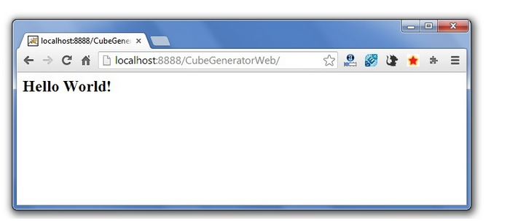
Output

Slide 69
Maven Webapp in Eclipse

Slide 70
We can import the maven project in eclipse
1) Open eclipse IDE
2) Import the maven project
File Menu -> Import -> Maven -> Existing Maven Projects

Slide 71
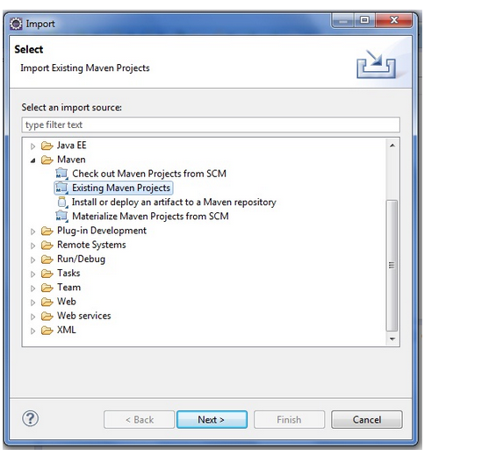

Slide 72
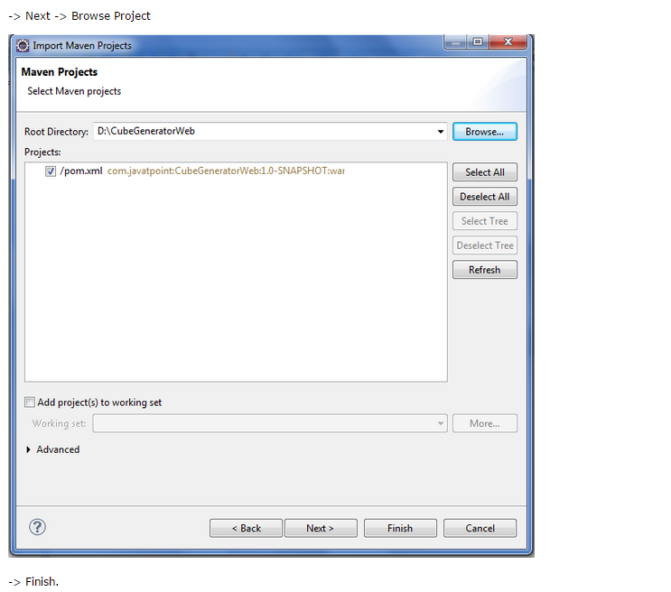

Slide 73
3) Run the maven web project
Right click on project -> Run As -> Run on Server

Slide 74
Maven plugins
The maven plugins are central part of maven framework, it is used to perform specific goal.
According to Apache Maven, there are 2 types of maven plugins.
Build Plugins
Reporting Plugins

Slide 75
Build Plugins
These plugins are executed at the time of build. These plugins should be declared inside the <build> element.

Slide 76
Reporting Plugins
These plugins are executed at the time of site generation. These plugins should be declared inside the <reporting> element.

Slide 77
Maven Core Plugins
Plugin | Description
clean | clean up after build.
compiler | compiles java source code.
deploy | deploys the artifact to the remote repository.
failsafe | runs the JUnit integration tests in an isolated classloader.
install | installs the built artifact into the local repository.
resources | copies the resources to the output directory for including in the JAR.
site | generates a site for the current project.
surefire | runs the JUnit unit tests in an isolated classloader.
verifier | verifies the existence of certain conditions. It is useful for integration tests.

Slide 78
3. Maven Plugins
Maven has a concept of plugins that let you implement added functionality to your build cycle. Learn about the Jetty plugin that lets you spin up a servlet container right from a Maven command. Also, learn how to integrate Maven with Eclipse.

Slide 79
3.1 Introductions to plugins with maven compiler plugin
Plugins are used to add some functionality to the application.

Slide 80
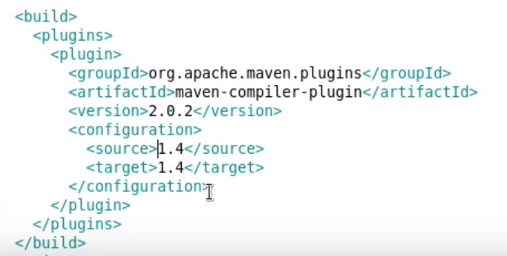
Here <source> value specifies the JAVAEE 4 version

Slide 81
Generics are added in JAVA SE5
import java.util.ArrayList;
import java.util.List;
public class MyClass{
public static void main(String[] args) {
List<String> namesList = new ArrayList<String>();
}
}

Slide 82
Run the maven commands
Mvn compile
It throws compile time error. Says that generics are not supported in source 1.4
Now change <source> value to 1.5 in compiler plugin entry
<source>1.5</source>
Run it again
Mvn clean compile

Slide 83
Note
Mvn clean compile
More than one MVN command can be executed

Slide 84
How to reflect the changes in class file?
Make the configuration entry in plugin
<configuration>
<scanIntervalSeconds>5</scanIntervalSeconds>
</configuration>
Here Maven looks for changes in class file per every 5 seconds

Slide 85
Note
Jetty plugin automatically deploy the web application in to the webserver

Slide 86
List of Maven Plugins
To see the list of maven plugins, you may visit apache maven official website http://repo.maven.apache.org/maven2/org/apache/maven/plugins/. Maven plugins are also available outside the maven atcodehaus.org and code.google.com.

Slide 87
Maven Eclipse

Slide 88
Follow the below link: it’s more enough to learn Maven with Eclipse
http://www.vogella.com/tutorials/EclipseMaven/article.html

